Slide 1


CLASSIFYING HOST LISTINGS AND UNDERSTANDING CUSTOMER PREFERENCES IN NEW YORK CITY

Slide 2


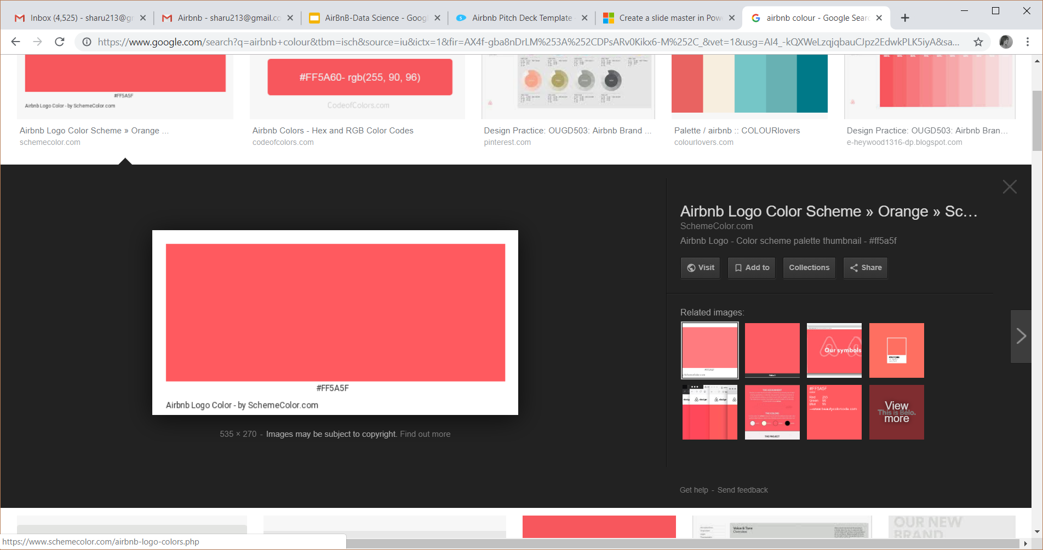



What is Airbnb?
Accommodation Business
Platform to connect users to host customers
Headquarters
Founded
Listings
San-Francisco, California, United States
August, 2008
4 million across 191 countries

Slide 3

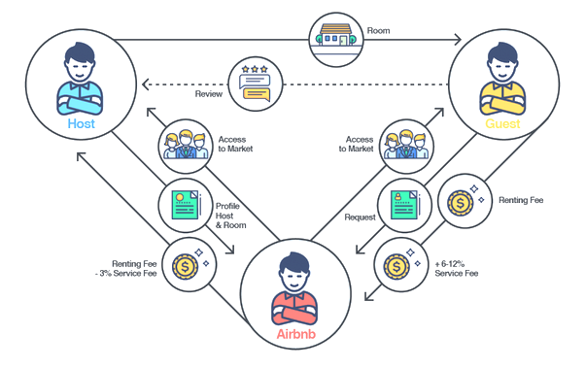
How Does Airbnb Work?

Slide 4



Objective
FOR THE HOST:
Determining the pre-requisites for the hosts to feature their listing in ‘Top-100’
FOR THE CUSTOMERS:
Building a R-shiny application for easy browsing of listings for Customers

Slide 5




Airbnb in New York
Data Source
Data Used
Inside Airbnb
Listings & Calendar
Unique Listings
Duration
44,317
Oct, 2017-Dec, 2018

Slide 6








Variables Used
Property Description
Amenities
Guest Details
About The host
Pricing Details
Area Description
Reviews
Booking and Availability

Slide 7

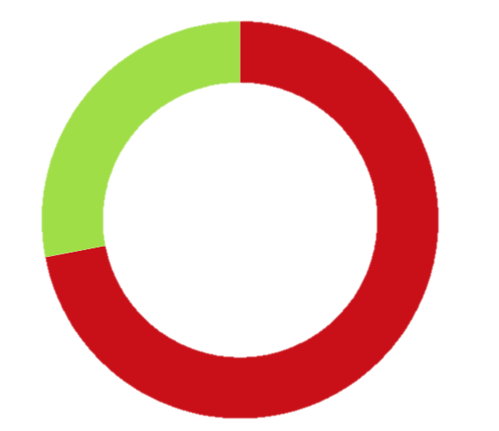
Target Variable
The target variable “is_top_100” is a derived binary variable
The binary values 1 and 0 signify whether the listing makes the top 100 list or it doesn’t, respectively
It is calculated using the parameters ‘no. of reviews’ and ‘review scores rating’
Top 100
Not Top 100

Slide 8

Data Insights

Slide 9

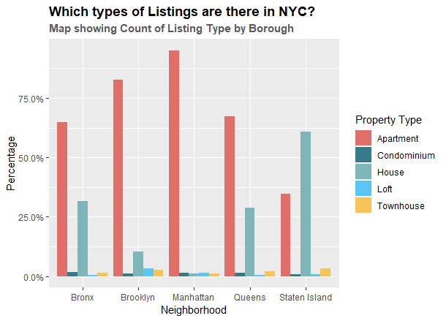
Neighbourhood Vs.
Property Type

Slide 10
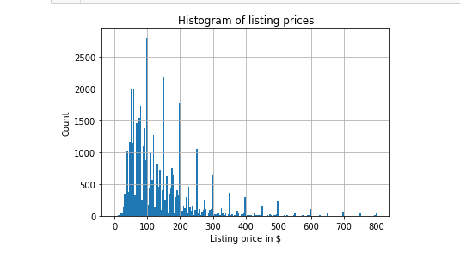
How Are The Listings Priced?

Slide 11
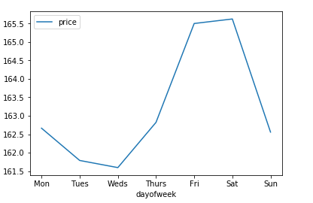
Most Profitable Days

Slide 12
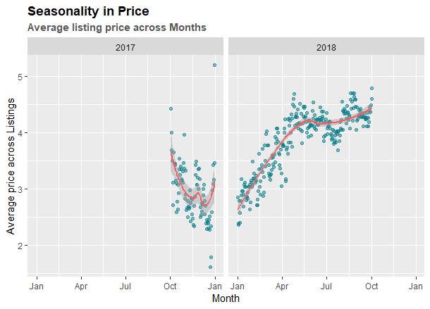
Seasonality
In
Prices

Slide 13
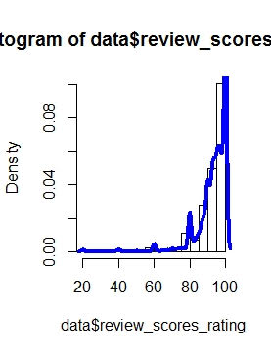
Distribution of Review Scores Rating

Slide 14
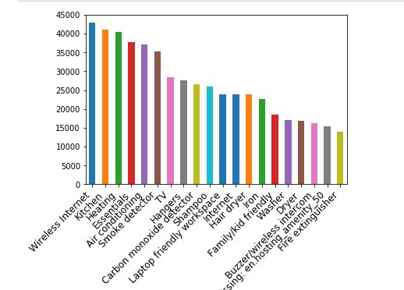
20 Must
Have
Amenities

Slide 15


Feature Selection
The features selected for the model are the those variables which work best for the model.
Information Value
Data Analysis
Provides a good measure of how well independent variables are able to distinguish between binary target variable
Helps to rank variables on the basis of their importance
Plotting the independent variables with target variable and observing the distribution of listings

Slide 16
Feature Selection
Require Guest Picture
Require Guest Phone Verification
Hosting Duration
Host Listings Count
Review Scr Accuracy
Bed
Bathrooms
Host Local
Review Scr Check-in
Review Scr Location
Review Scr Communication
Review Scr Clean
Price
Neighbourhood Group
Review Scr Value
Review Scr Rating
Cancellation Policy
Price Per Person
Accommodates
Bedrooms

Slide 17
SMOTE
SMOTE stands for Synthetic Minority Oversampling Technique
It is a statistical technique for increasing the number of cases in the dataset in a balanced way
The module works by generating new instances from existing minority cases that are supplied as input
DATA(SMOTE)
0
1
900
400
Notes:
Classification using class-imbalanced data is biased in favor of the majority class. The problem can be attenuated by undersampling or oversampling, which produce class-balanced data.
an over-sampling approach in which the minority class is over-sampled by creating “synthetic” examples rather than by over-sampling with replacement.
We generate synthetic examples in a less application-specific manner, by operating in “feature space” rather than “data space”. The minority class is over-sampled by taking each minority class sample and introducing synthetic examples along the line segments joining any/all of the k minority class nearest neighbors. Depending upon the amount of over-sampling required, neighbors from the k nearest neighbors are randomly chosen
https://docs.microsoft.com/en-us/azure/machine-learning/studio-module-reference/smote

Slide 18

Train & Test Data
Train
Test
0
1
0
1
625
284
275
116

Slide 19

Logistic Regression
Logistic Regression is a classification algorithm
It is used to explain the relationship between one dependent binary variable and one or more nominal, ordinal, interval or ratio-level independent variables.

Slide 20

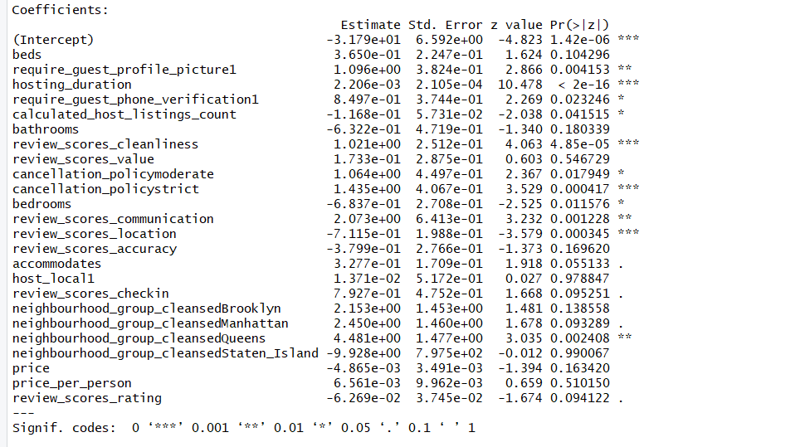
Conclusion with Logistic Regression
Require guest profile picture
Hosting duration
Require guest phone verification
Calculated Host Listings
Review score cleanliness
Cancellation policy moderate
Cancellation policy strict
Review scores communication
Bedrooms
Review Scores Location
Neighbourhood Cleansed

Slide 21
Confusion Matrix
Actual Predicted | Not Top 100 (0) | Top 100 (1)
Not Top 100 (0) | 237 | 22
Top 100 (1) | 38 | 94

Slide 22
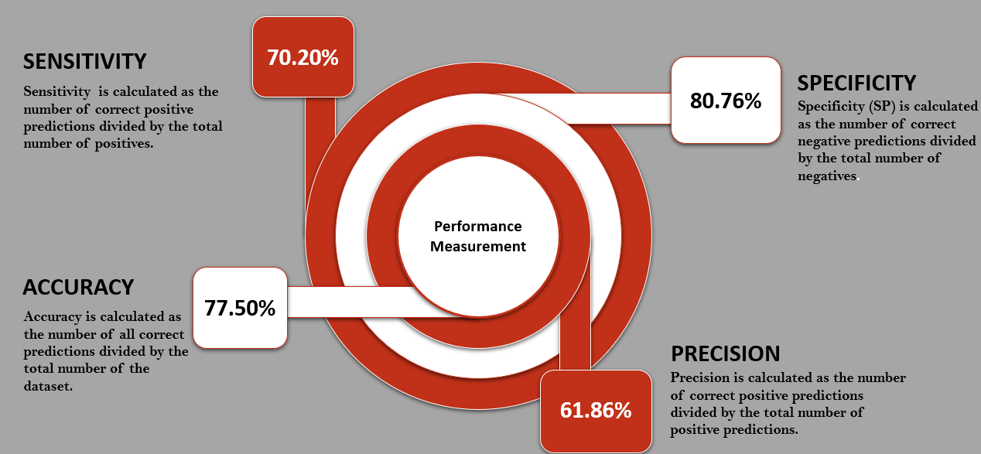
Performance Measures
81.03%
86.18%
84.65%
71.21%

Slide 23

Decision Trees
Supervised, non parametric machine learning algorithm.
It is a graphical representation of tree like structure with all possible solutions.
The decision rules are generally in form of if-then- else statements.
They empower predictive modeling with higher accuracy, better stability and provide ease of interpretation.
Notes:
Easy to interpret. Straightforward graphical visualization is intuitive makes it easy for anyone to understand
Useful to identify variables most helpful in prediction. It splits based on the attribute significance.
Handles both continuous and categorical targets attributes.
Not influenced by outliers and missing values to an extent.
Non parametric method- does make an assumption about the form of the mapping function. As they do not make any assumption about mapping function they are free to learn any functional form present in the data
Trees can handle qualitative input variables without the need to create dummy variables
Regression Trees: Regression Trees are the types of Decision Trees which mostly work on input variables which are continuous. Any prediction of an unseen data is hence predicted by the mean value.
Classification Trees: Classification Trees Learning Model, unlike the Regression counterparts, works with the categorically dependent input variables

Slide 24
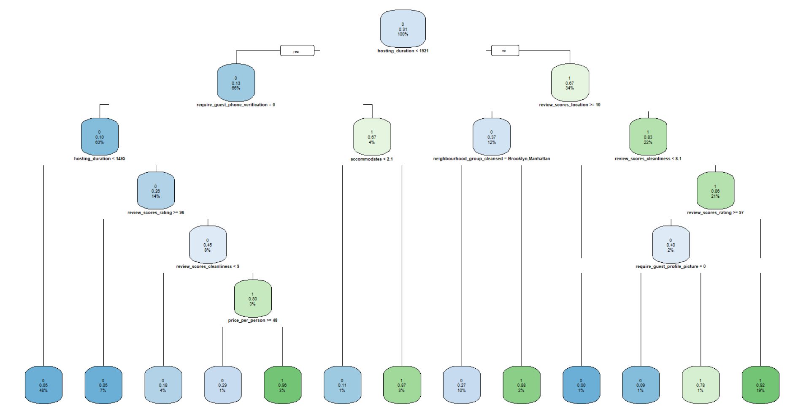
Decision Tree

Slide 25
Confusion Matrix
Actual Predicted | Not Top 100 (0) | Top 100 (1)
Not Top 100 (0) | 253 | 22
Top 100 (1) | 44 | 72

Slide 26
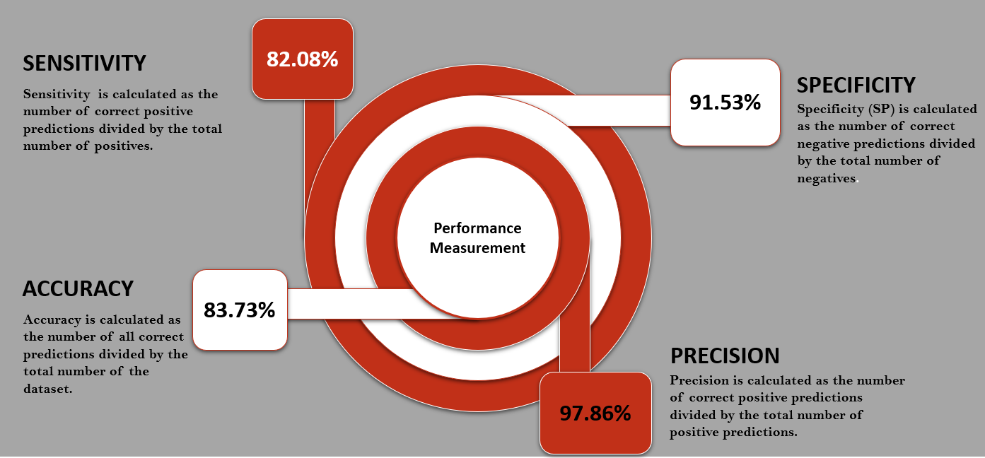
Performance Measures
85.19%
76.6%
83.12%
92.00%

Slide 27

Conclusion with Decision Tree
Hosting duration should be at least 5 years or guests should be verified via phone call and hosts should accommodate at least 2 guests
If the host has experience of 3-5 years, he should make sure that the price per person is less than $48
Properties of Bronx, Staten Island and Queens should have a location score of 10 and a hosting experience of min 5 years
Properties with 5+ years of experience need not have an overall rating above 97 but must a cleanliness score of at least 8

Slide 28

The Potential 1’s
There were ‘11’ listings of interest which were actually not in the top 100 but predicted as top 100 from the analysis by two models
In all 2 features which are significantly responsible for the ‘0’s to be predicted as ‘1’s were found– Host Local, Property Type
We can say that these 2 features could be few of the deciding factors for the guests to choose their listing

Slide 29
R-Shiny
Shiny is an R package that makes to build interactive web apps straight from R.
To suggest the appropriate Airbnb property preferences in New York.
Customer specific variables were chosen in order to facilitate easy selection for the guests.

Slide 30

Limitations & Future Scope
The results may not be generalizable to a larger population.
Images could not be extracted
Customer reviews data could have been utilized for more insights

Slide 31

Acknowledgement
We would like to extend our thanks to Mr. Prashant Dhamale and Miss. Ashita Dara for their guidance and constant support

Slide 32

THANK YOU
- Nevina Dalal (A004)
Aanchal Gaggar (A010)
Aditya Jani (A012)
Sharvari Gokhale (A031)

